Slide 1
The challenges for researchers
Dr. Maria Angels Oliver and Dr. Dario Zammerini
IRTA, Barcelona
Boars heading for 2018, Amsterdam 01/12/2011

Slide 2
Present situation
Research on boar taint has been carried for decades!
Different kind of funded research projects: national, European and private
At present we have a wide knowledge of this complex issue:
PIGCAS
ALCASDE
SABRE

Slide 3
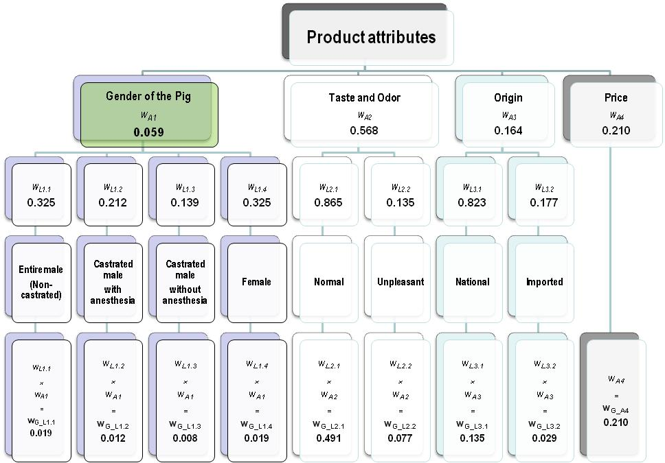
ALCASDE project Demand and acceptance of consumers
Task 1.3.5. Analyses of the data from attitudes
Buying factors
ES

Slide 4
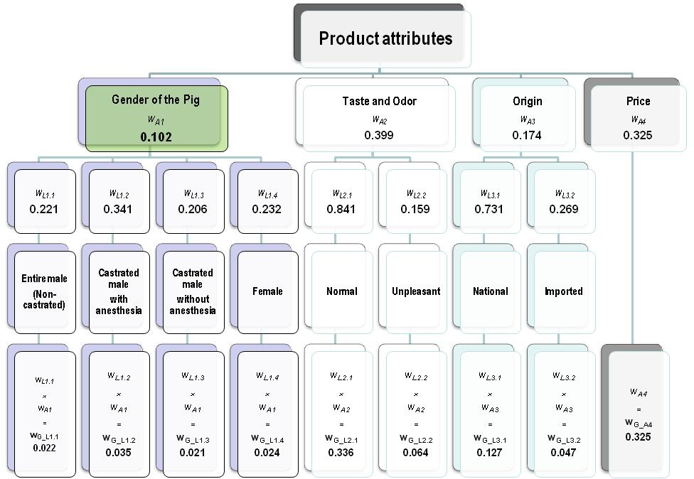
ALCASDE project Demand and acceptance of consumers
Task 1.3.5. Analyses of the data from attitudes
Buying factors
NL

Slide 5
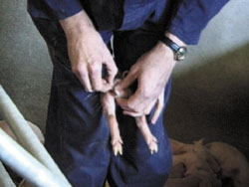
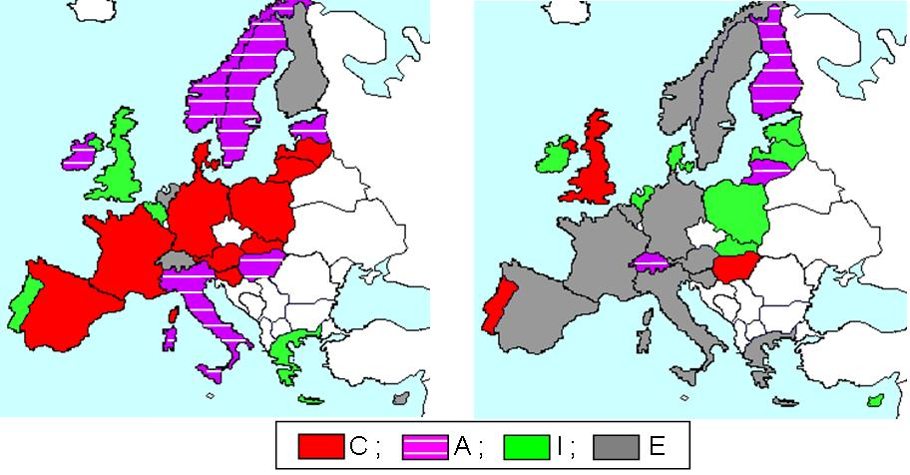
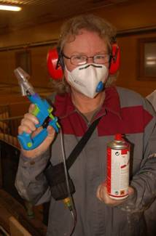
PIGAS project
PIGCAS WP1 - Survey on the attitudes of stakeholders in relation to piglet castration and alternatives in Europe
Most preferred (left hand side) and less preferred (right hand side) alternatives of 174 pig producers, according to country (2007-2008)
C = Surgical castration; A = Castration with anaesthesia
I = Immunocastration; E = entire males

Slide 6
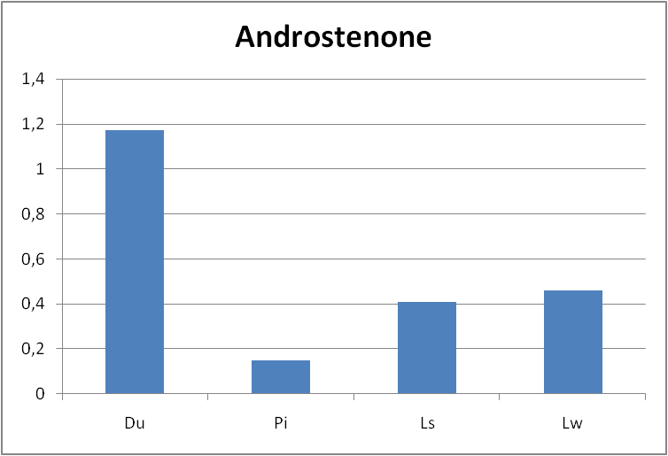
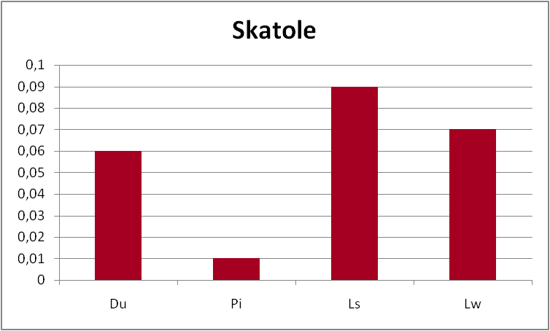
Results from SABRE project (Xargay et al., 2010)
Duroc-68
Pietrain-19
Landrace-76
Large White-58

Slide 7
Which is the incidence of tainted carcasses?
Different studies:
Walstra et al. (1999), 6 countries 29% (12-43%) over androstenone threshold (1.0 μg/g)
11% (2-20%) over skatole threshold (0.25 μg/g)
Prusa et al. (2011)
56% over androstenone threshold (1.0 μg/g)
34% over skatole threshold (0.20 μg/g)
Allison et al. (2011)
18.5% of high risk carcasses

Slide 8
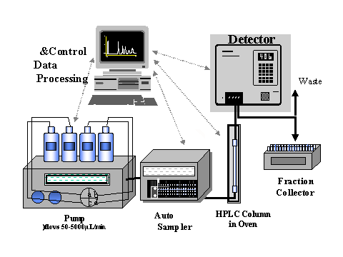
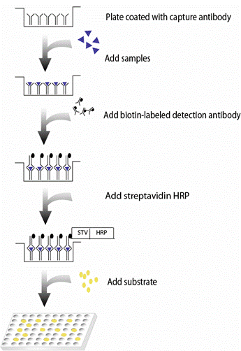
The results are not comparable
Need for a reference method of detection
Need to standardize the data
EU Commission Implementing Decision (2011/C 243/06)
EU agreement with the Joint Research Centre, Institute for Reference Materials and Measurements (JRC-IRMM)

Slide 9
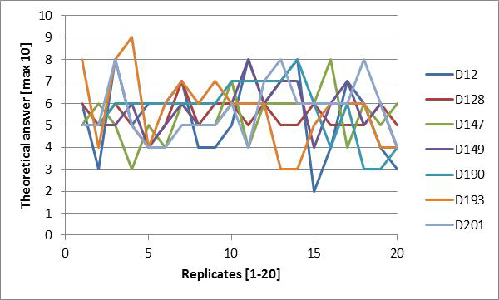
Different methods for on-line detection
Human nose:
change in sensitivity during evaluation of 200 fat samples (10 pig samples x 20 replicates) by 7 panellists using “hot water” method
Meinert et al., 2011

Slide 10
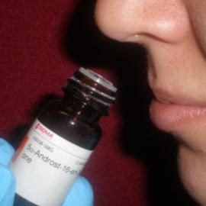
New methods for on-line detection
Electrochemical biosensor, electric nose and others
Characteristics needed:
Rapid to be used on-line
Detection of all boar taint compounds
Cost effective and user-friendly
Human nose: a temporary solution?
Objectives of new methods:
To sort out carcasses and meat and meat products that could be rejected by the consumers!

Slide 11
New methods for on-line detection
EU Commission Implementing Decision (2011/C 243/06)
Fund to create an European network of researchers and
a forum discussion on the subject
Need for research on new technologies

Slide 12
Market differentiation
Duroc crosses
IMF 4%
Pietrain crosses
IMF 1.6%
Two different type of quality from standart production systems

Slide 13
Market situation
Which are the requirements of internal EU markets?
Which are the requirements of exporting markets?

Slide 14
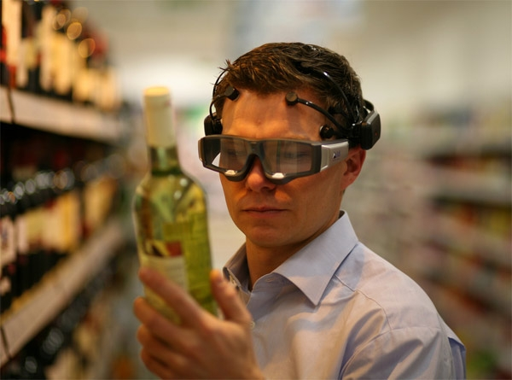
Buying decision
An emotional concept?
Consumer behavior and thinking → analysis of cerebral area
Consumer decision!!!!
What happens if consumer do not find good quality?
Why do consumers stop eat pork?

Slide 15
Buying decision
High and medium risk of boar taint → poor eating quality!
Rarely consumer complain, but...
SOLUTIONS?
No love at first bite
Consequences:
Negative effect on consumer perception
Decline on pork consumption

Slide 16
Different strategies to mask
Different studies:
Lunde et al. (2008)
Marinating → chops with skatole content of approximately 0.4 ppm appeared similar to castrates. Chops with skatole contents above 0.7 ppm remained unmasked
Tørngren et al. (2011)
Smoked-cooked ham → all odour attributes can be eliminated when serving ham cold (23°C). Entire males with androstenone level above 0.4ppm cannot be used

Slide 17
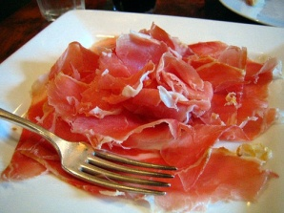
Consumers’ concerns
EU Commission Implementing Decision (2011/C 243/06)
Open call for tender
Consumer acceptance in the EU and third countries of pork and meat products form entire males
Objective: study the markets and the differences in consumer eating acceptability

Slide 18
Consumers’ concerns
FUTURE WORKS???
Promote a research programme to enhance the eating and nutritional quality of pork at an European level including consumer behaviour

Slide 19
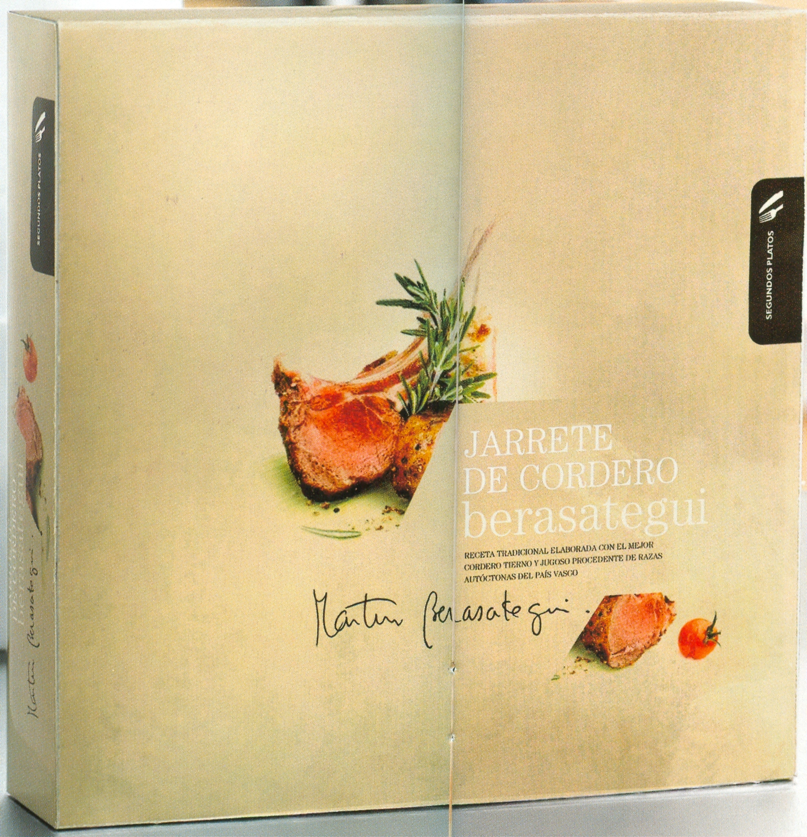
Haute cuisine at home!!!
Must we renounce to have pork in haute cuisine ?
Need for new branding culture

Slide 20
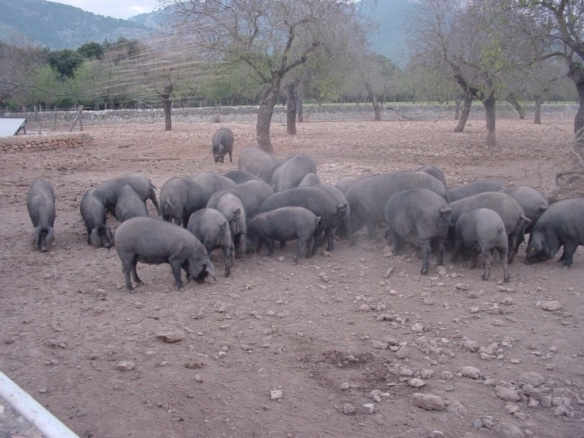
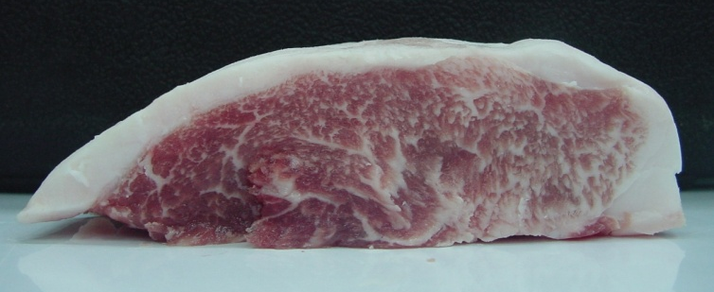
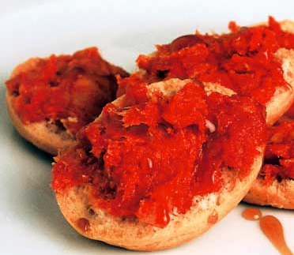
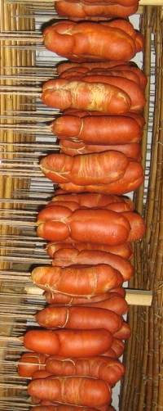
ALTERNATIVE PRODUCTION SYSTEMS
Iberic,
Majorcan Black, Alentejano, Cinta Senese, Nero Siciliano
Apart from sensory quality, meat and meat products from Mediterranean breeds have an added value related to their particular production system and to a cultural and regional tradition.

Slide 21
ALTERNATIVE PRODUCTION SYSTEMS
WHAT IS THE SOLUTION FOR THESE
PRODUCTION SYSTEMS TO KEEP
THEIR QUALITY: ETHICAL, NUTRITIONAL,
SENSORY...????
IS IMMUNOCASTRATION THE SOLUTION?
IS CASTRATION WITH ANAESTHESIA THE SOLUTION?

Slide 22
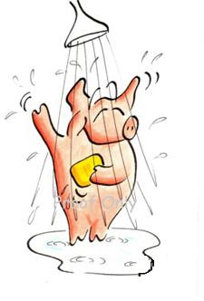
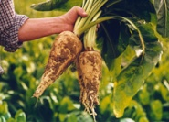
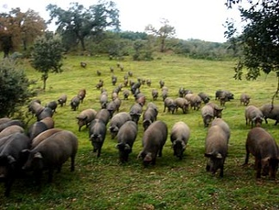
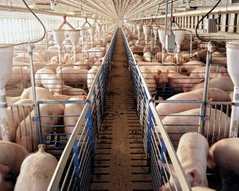
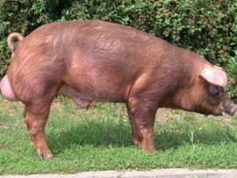
We need to look for solutions, research can help: breeding, feeding and management
- How much the quality is influenced by the production system?
Is the system of production considered part of the quality of the product by the consumers?
How traditional systems can avoid boar taint problems after castration ban?
The European Declaration on alternatives to surgical castration of pigs foresee a derogation for “pig meat registered under "traditional specialties guaranteed" or with "geographical indications" and pig meat produced for traditional high quality products”

Slide 23
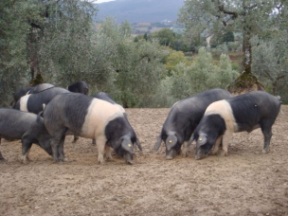
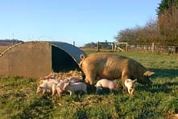
Alternative production systems
Alternative production systems
Traditional systems
Sustainable systems
Help for local economy
Main objective is Quality
Ethical
Meat / Pork products

Slide 24
Economic issue?
Growth performance (least square means) of castrated male (CM), vaccinated with Improvac® (IM) and entire males (EM)
Feed conversion rate | CM | IM | EM
Start to V2 | 2.31a | 2.10b | 2.12b
From V2 to slaughter | 3.43a | 2.98b | 3.20b
Global | 2.76a | 2.51b | 2.48b
Fàbrega et al. (2010)
EU Commission Implementing Decision (2011/C 243/06)
One study and economic analysis of the cost and benefits of ending surgical castration

Slide 25
Conclusions
We need to promote research calls to FP7 and next programmes of research in the EU to find the answers
We need to work together with the meat sector to satisfy consumer demands

Slide 26
THANK YOU FOR YOUR ATTENTION!
M. Angels Oliver
Mariaangels.oliver@irta.cat

