Slide 1
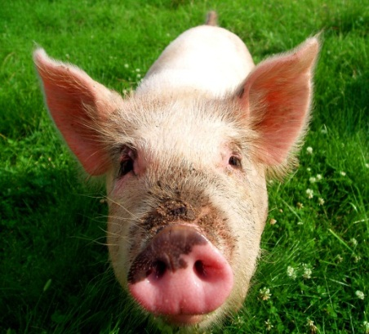
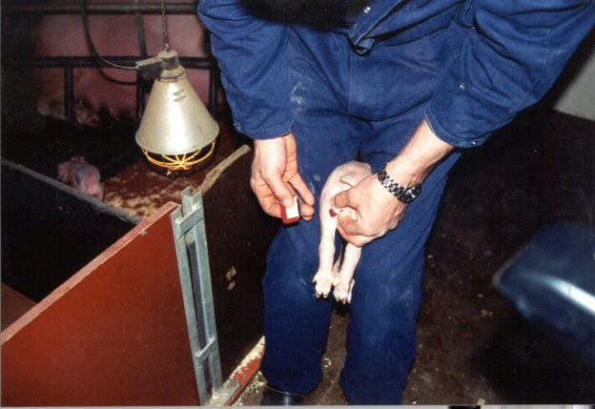
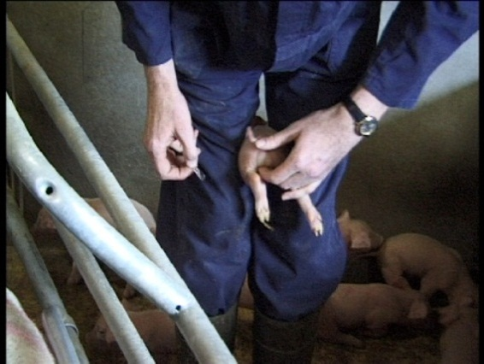
Boars heading for 2018:
A NGO perspective
Michel COURAT
Policy Officer - Farm Animals
Boars 2018 01/12/2011

Slide 2
OVERVIEW
Introduction
European declaration on alternatives to surgical castration of pigs
Positive points
Concerns
European partnership
Conditions of success
Boars 2018 01/12/2011

Slide 3
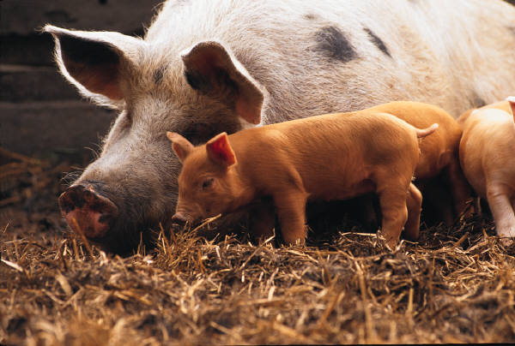
Introduction
A major issue
15 months ago…
Role of EC & Belgian presidency
Amsterdam
Boars 2018 01/12/2011

Slide 4
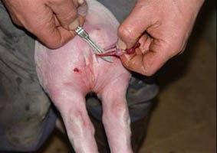
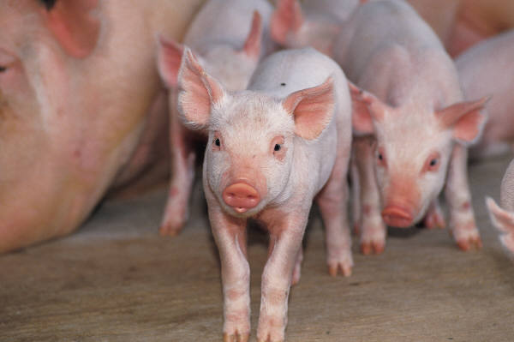
European Declaration
A major step forward for pig welfare
Two clear deadlines:
> 01/01/2012: prolonged analgesia and/or anaesthesia
> 01/01/2018: surgical castration banned
pict Ilvo

Slide 5
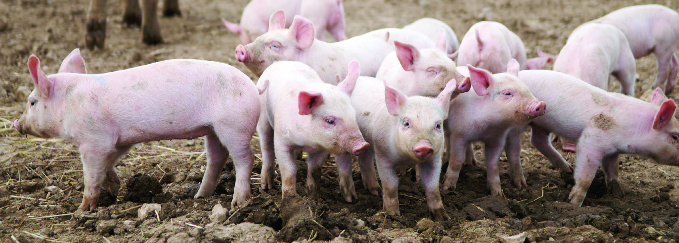
Positive points
Creation of an European partnership
Supported and funded by the E C
Control system: yearly public report
Objective assessment

Slide 6
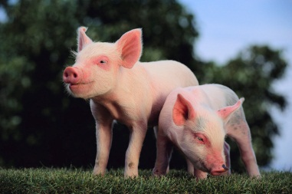
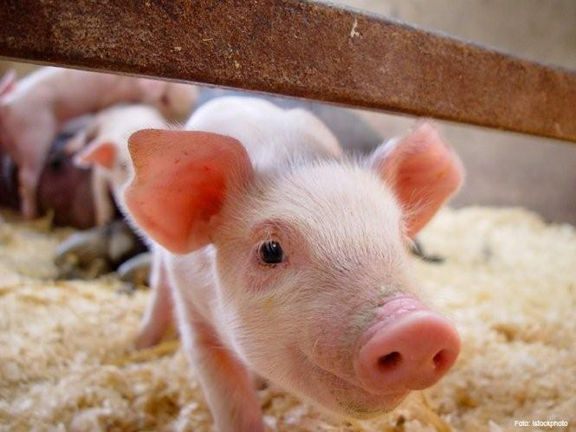
Positive points
Development of proposed tools
Methods / assessment of boar taint ( BT)
Reference methods
Detection Slaughter line
< compounds by pig breeding, management & feeding
Entire males

Slide 7
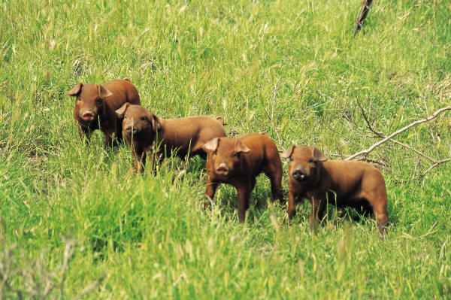
Positive points
Voluntary commitment, not legal obligation
First example in AW of commitment of a whole ( ?) sector, first step…
Major players and stakeholders
Commitment / measureable actions
Stronger / legislation ?
Quicker ?

Slide 8
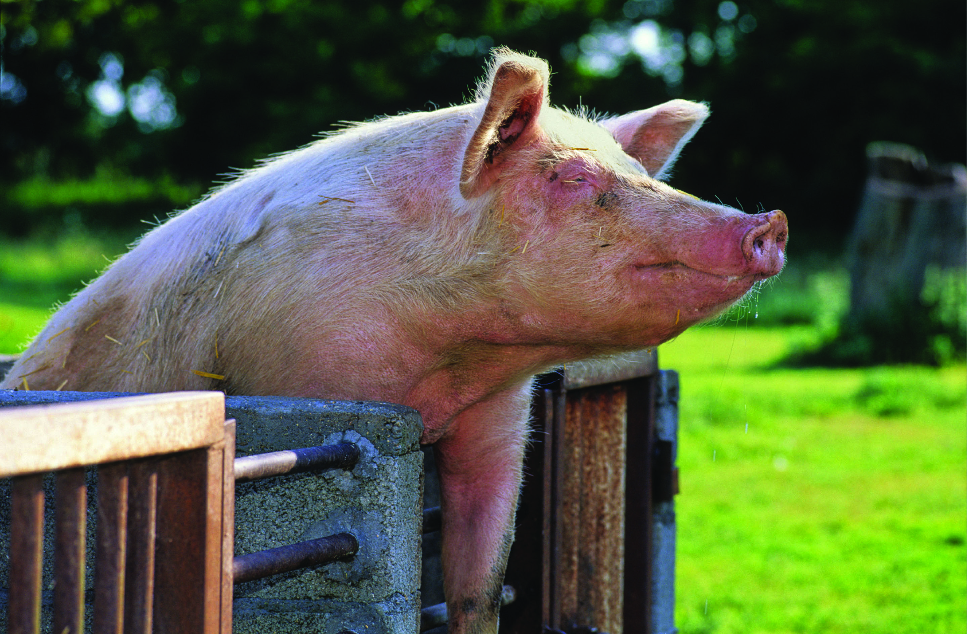
Other positive aspects
Corporate Social Responsibility
Positive image given to consumers and citizens
+ Feed conversion rate & environment
Cost sharing
It is achievable !
We will stay
very vigilant

Slide 9
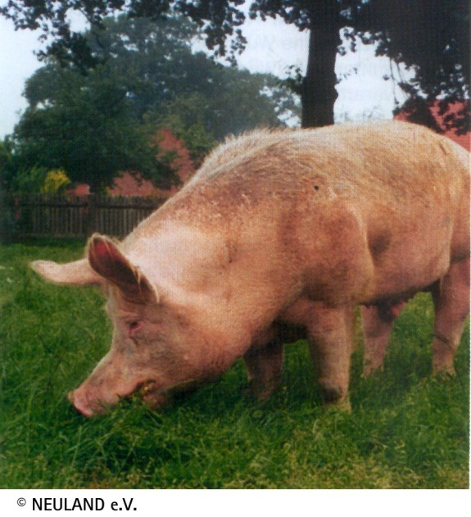
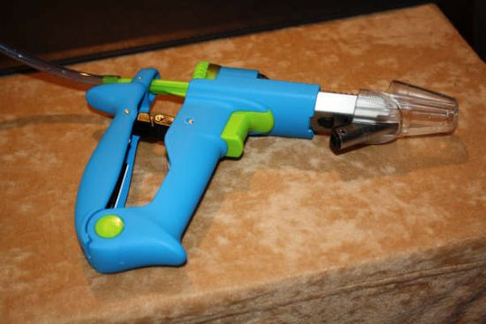
Some concerns / Declaration
2018 Deadline
Option of Analgesia only :
compromise, temporary, in practice, German AW NGo
Heavy pigs and derogations
Place of immunocastration:
Available, Safe, AW more friendly
Cost effective, Environment
Heavy pigs

Slide 10
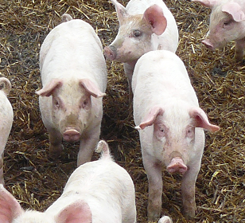
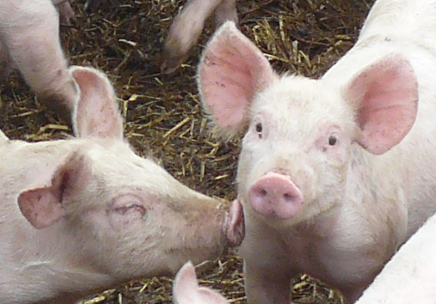
Some concerns / first developments
Signatories: “ Whole sector”...?
Effective implementation > 01/ 01/2012 ?
Communication ….
Partnership in 2012 ?

Slide 11
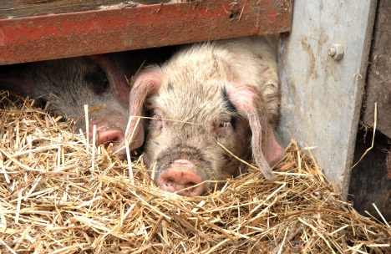
European Partnership
WHO ?
Whole sector
Research and technical institutes
NGOs
+
DG SANCO, DG AGRI,
DG JRC-IRMM
DG RTD, DG ENV, DG Enterprise and Industry

Slide 12
Concrete actions
European partnership: financing decision August 2011
Before the end of the year:
website EPS, JRC reference methods, consumers’ study
Early 2012:
Studies: BT compounds, slaughter line, cost sharing
Other Actions: 2012 ?
R & D + Results: Recognized methods, Entire males, List of TP/ heavier pigs, Alternatives, Info and training
Importance of annual public report

Slide 13
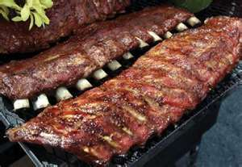
Conditions of success
All stakeholders have to fairly play the game
No of signatories and participants to EPS
Retailers, Food service companies, Food manufacturers are key drivers
Effective development of Tools
Role of Commission: establishing, funding and supporting European partnership
Role of NGOs: very supportive… but vigilant
Effective and independent reporting essential
Role of this Seminar

Slide 14
Boars heading for 2018
This conference is an essential tool
To assess what has been done so far
in particular 01/01/2012
To measure what has still to be done
To build and strengthen relationships among stakeholders
To encourage all those who have not signed yet to do it
- No one should stay behind -

Slide 15
No one should stay behind
THANK YOU
for your attention
Thank you LD

