Slide 1
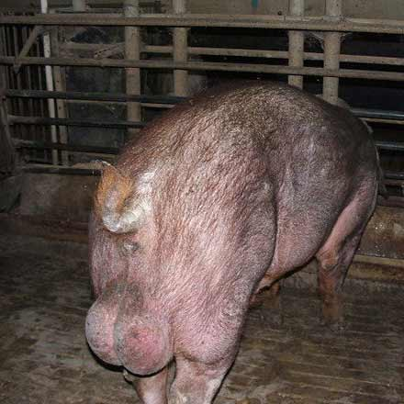
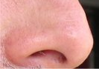
Detection of boar taint by Human nose
Validation of the hot water method
Lene Meinert, ph.d.
DMRI, Center of Meat Quality
lme@dti.dk

Slide 2
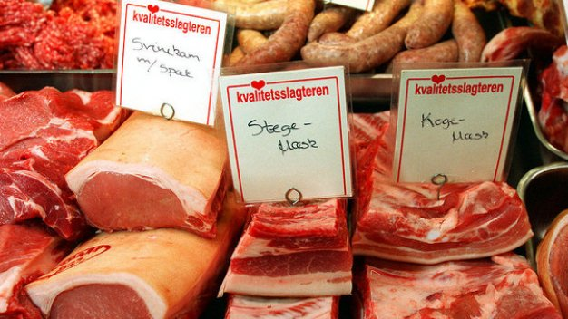
Content
Background
Presentation of the hot water method
Validation work
Procedure for test and training of assessors

Slide 3
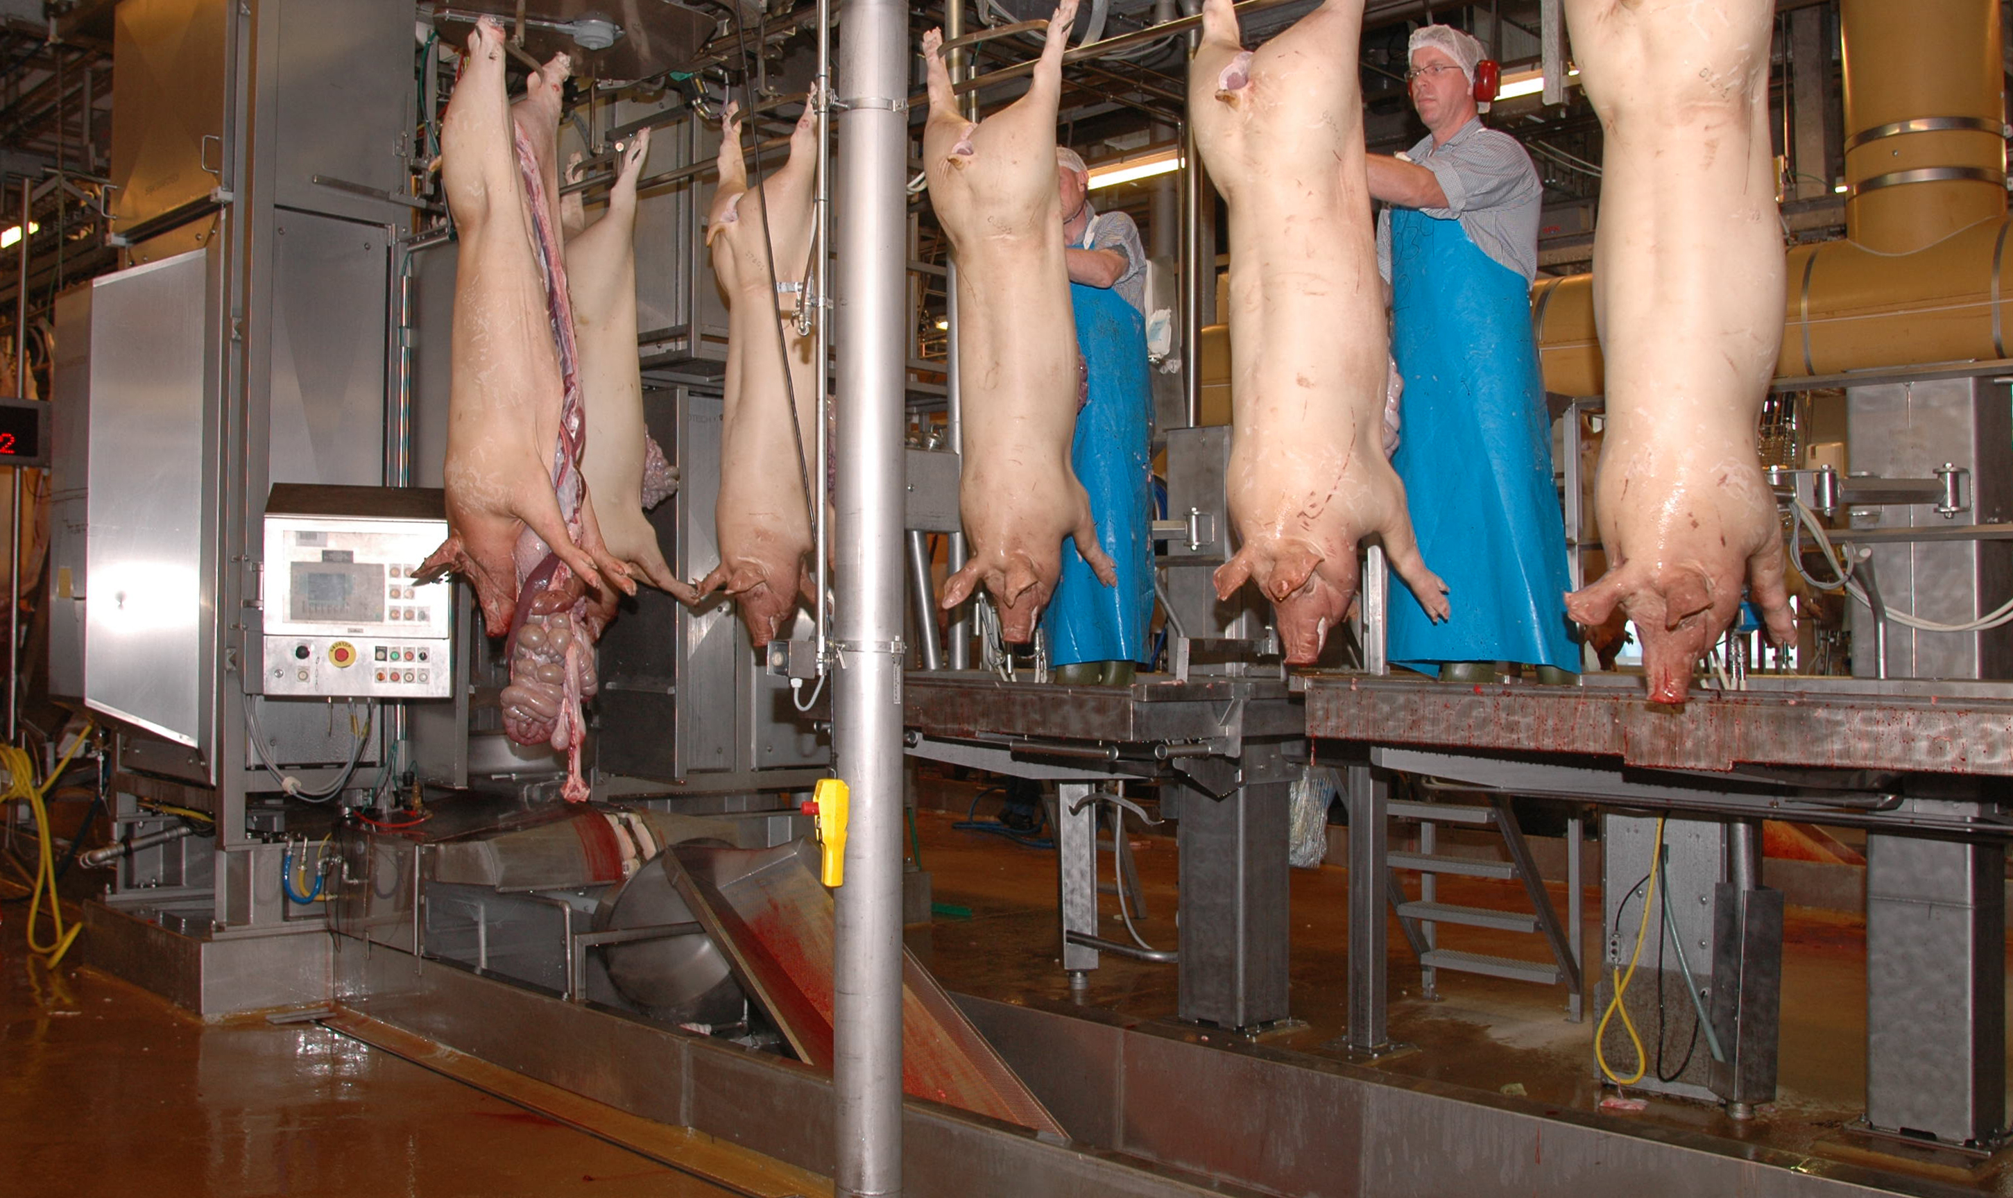
Background
Why choose the hot water method?
Method for smaller (niche) productions of boars
Simple and in-expensive
At-line method
Sensory based concern
Smell and noise

Slide 4
The hot water method
100 mL sample flask
5 g lard (medium size)
75 mL boiling hot water
Stand for 2 min
Assess the samples
Scale: Keep it simple!
0 = no boar taint,
1 = week boar taint
2 = clear boar taint
3 = doubt

Slide 5
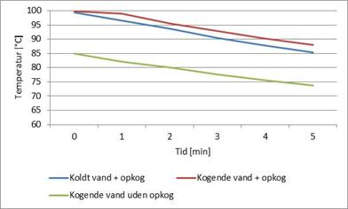
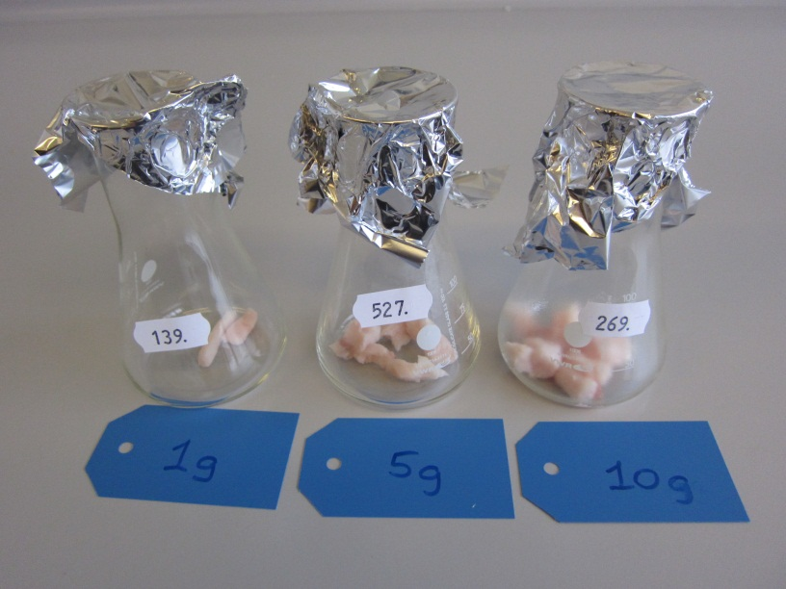
Validation - practical aspects
Time and temperature
Amount
Size
Shelf-life, 5 days

Slide 6
How many samples?
200 samples in one day - 10 pigs with 20 replicates
DMRI-panel
Slaughter house panel 1
Slaughter house panel 2
No systematic change
in sensitivity
A lot of handling with sample preparation

Slide 7
Organic vs. conventional
Any differences in the tainted odour?
No, not any systematic difference found !
[Androstenone]

Slide 8
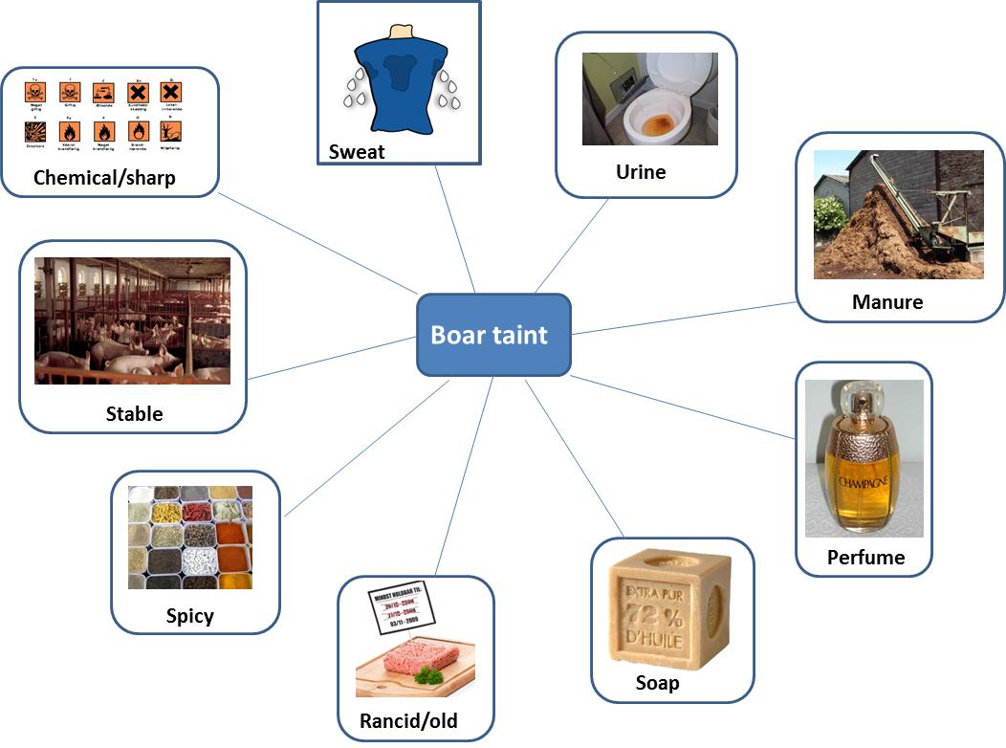
The many odours

Slide 9
Test and training of assessors
Procedure
Test for androstenone sensitivity (4 AFC-test)
Recognition of skatole and androstenone in oil + reference
Recognition of skatole and androstenone in minced pork + reference
Assessment of boar taint in minced pork
Assessment of boar taint in lard
319
277
689
124
Water
A
40 ppm
Water
Water

Slide 10
Summing up
Test and training of assessors is crucial
The Hot water method is simple and robust
Sample preparation is a limitation

