Slide 1
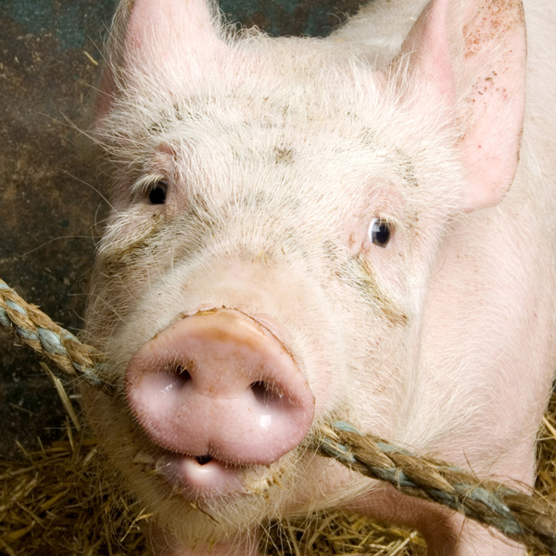


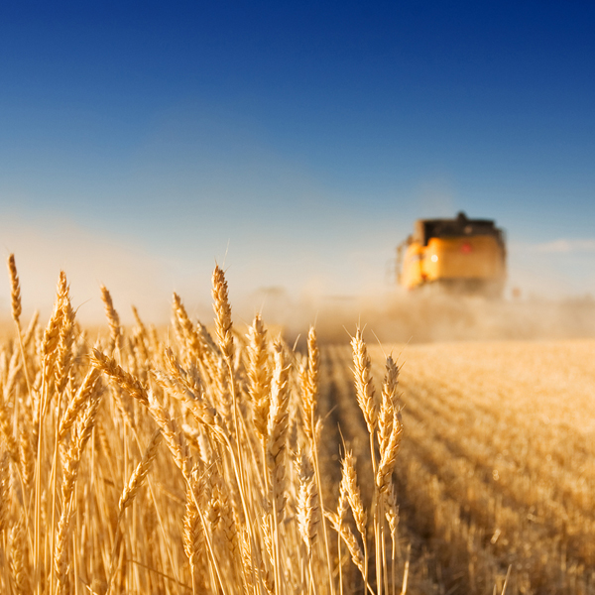
Management and farm characteristics associated with boar taint and aggressive behaviour on Dutch pig farms
2-12-2011, C. van Wagenberg, B. van der Fels, C. van der Peet-Schwering, H. Snoek, and L. Heres
1

Slide 2
Content
Introduction
Goal
Questionnaire
Analysis
Results
Conclusion
2

Slide 3
Introduction (I)
Since 2009 in-line measurement of deviant smell
On average 3-4% of carcasses deviant smell
Variation in % deviant smell between farms
3

Slide 4
Introduction (II)
Aggressive behaviour boars important problem for producers
Large variation in perceived aggressive behaviour of boars between producers
4

Slide 5
Goal
Identify farm and management factors that are associated with the percentage deviant smell and aggressive behaviour of boars
5

Slide 6
Questionnaire
Possible factors from literature and experts
Questionnaire sent to professional boar farmers
  ≥ 300 boars in ≥ 2 deliveries
  152 farmers
  101 respondents (66%)
  December 2010/January 2011
11 farmers with ≥ 2 location numbers and 1 questionnaire removed -> 90 remained for analysis
6
Notes:
Average boar taint % of these 90 farmers = 3.7%

Slide 7
Analysis
Two step regression analysis of factors on
  Average % deviant smell on farm level: measured in-line at slaughter
  Extent of aggressive behaviour: seriousness and frequency as perceived by farmer
Step 1: forward selection on subsets of related variables
  Subsets: aggression, light regime, hygiene, feeding strategy, stocking/marketing strategy, genetics
Step 2: multivariate regression with selected variables from step 1
7
Notes:
Log of % deviant smell because of the distribution
Agressie: agressiemean kleinoppervlak stroalsafleiding Vaneenvermeerderaar.
licht: hourslightcode1 hourslightcode4 natuurlijklicht .
hygiene (niet als voorspeller voor gedrag) moderniteit3 bollevloer hokbevuilingmean inwekenmetwater inwekenmetreinigingsmiddel .
voerstrategie: droogvoer voerstrategiecode2 voerstrategiecode3 EWvoer meerdantwaalfuur .
opleg en afleverstrategie: gescheidenopleg hoogopleggewicht afleveringminimaaldriekeer oplegtoomofleeftijd hergroeperingachterblijvers .
genetica: subfok percTopigszeug percLandvarkenzeug percZlijnzeug percTempobeer percTalentbeer percSubfokbeer percPietrain

Slide 8
Results: Boar taint
Variable | Standardized Coefficients | T-value | P-value
Constant | 0.000 | -26.817 | 0.000
Aggressive behaviour | 0.169 | 1.800 | 0.076
Dry feed | 0.160 | 1.692 | 0.095
Stocking weight piglets >26 kg | -0.175 | -1.891 | 0.062
Percentage of Z line sows | 0.216 | 2.293 | 0.024
Percentage of ‘Talent’ end boar | 0.298 | 3.189 | 0.002
Percentage of Pietrain end boar | 0.315 | 3.407 | 0.001
8
Notes:
Standardized coefficients: comparing impact between variables: unstandardized coefficient related to variance in that variable.
Unstand %boartaint rel.impact av.value range
Constant -3.956 1.91%
Aggressive beh. 0.109 2.13% 0.22% 3.5 1-5
Dry feed 0.15 2.22% 0.31% 0.75 0-1
Stocking weight piglets -0.162 1.63% -0.29% 0.33 0-1
Percentage Z line sows 0.005 1.92% 0.01% 15 0-100
Percentage ‘Talent’ boar 0.003 1.92% 0.01% 33 0-100
Percentage Pietrain boar 0.007 1.93% 0.01% 5 0-100

Slide 9
Results: Agressive behaviour
Variable | Standardized Coefficients | t-value | P-value
Constant | 0.000 | 25.057 | 0.000
>8 hours light per day | 0.157 | 1.526 | 0.131
Restrict feeding last period (ad libitum before) | 0.152 | 1.483 | 0.142
Percentage of Z line sows | 0.248 | 2.415 | 0.018
9

Slide 10
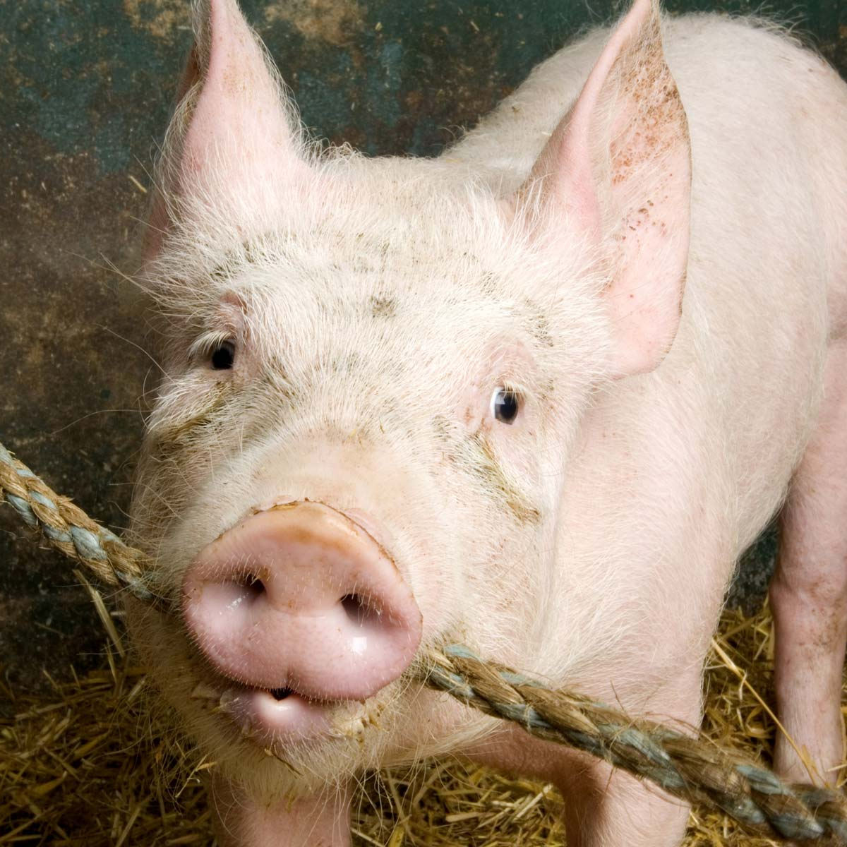
Conclusions
Boar taint associated with:
• Pietrain or ‘Talent’ end boar
• Z-line gilt
• Stocking weight piglets >26kg
• Aggressive behaviour
• Dry feed
Aggressive behaviour associated with:
• Z-line gilt
• (>eight hours of light per day)
• (Restrict feeding in last period and ad libitum before)
10

