Slide 1

On farm comparison of different alternatives for surgical castration without anaesthesia
Carcass quality and boar taint prevalence:
evaluation on 20 commercial farms
2) Comparison of meat quality and eating quality
Aluwé M., Millet S., Langendries K.C.M, Bekaert K.M., De Brabander D.L., Tuyttens F.A.M
Contact: Marijke.Aluwe@ilvo.vlaanderen.be
Boars heading for 2018
This study was funded by
The Agriculture and Fisheries Agency (Flemish government), Boerenbond, Belporc,
Flemish Centre for Agricultural and Fisheries Marketing (VLAM)
Notes:
voorblad

Slide 2
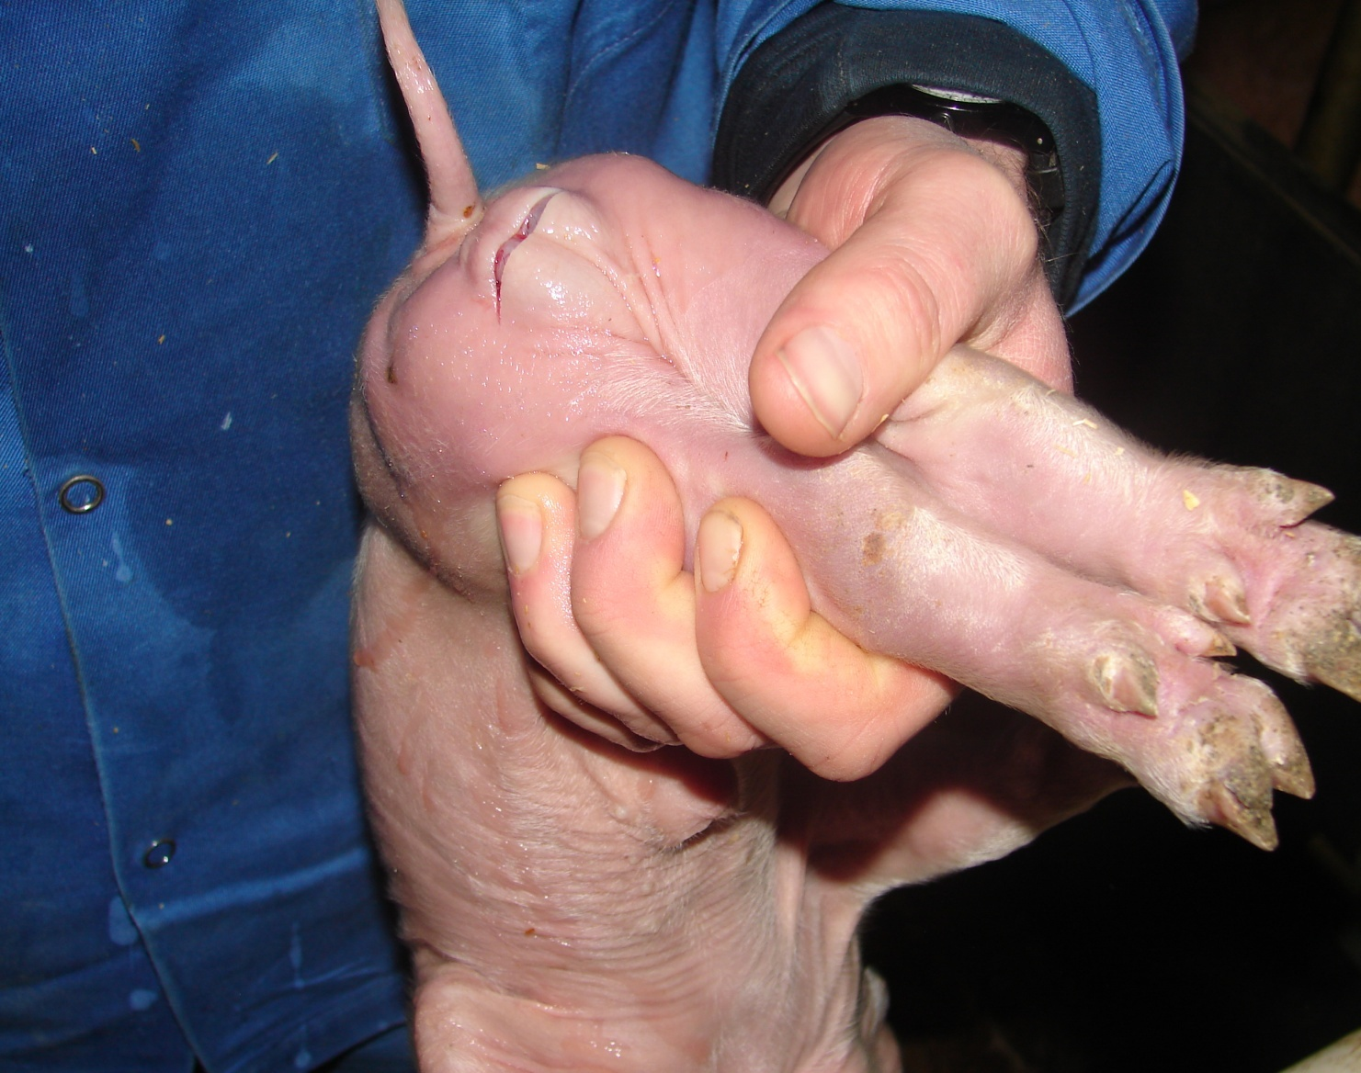
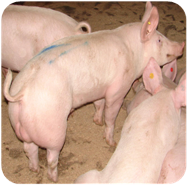
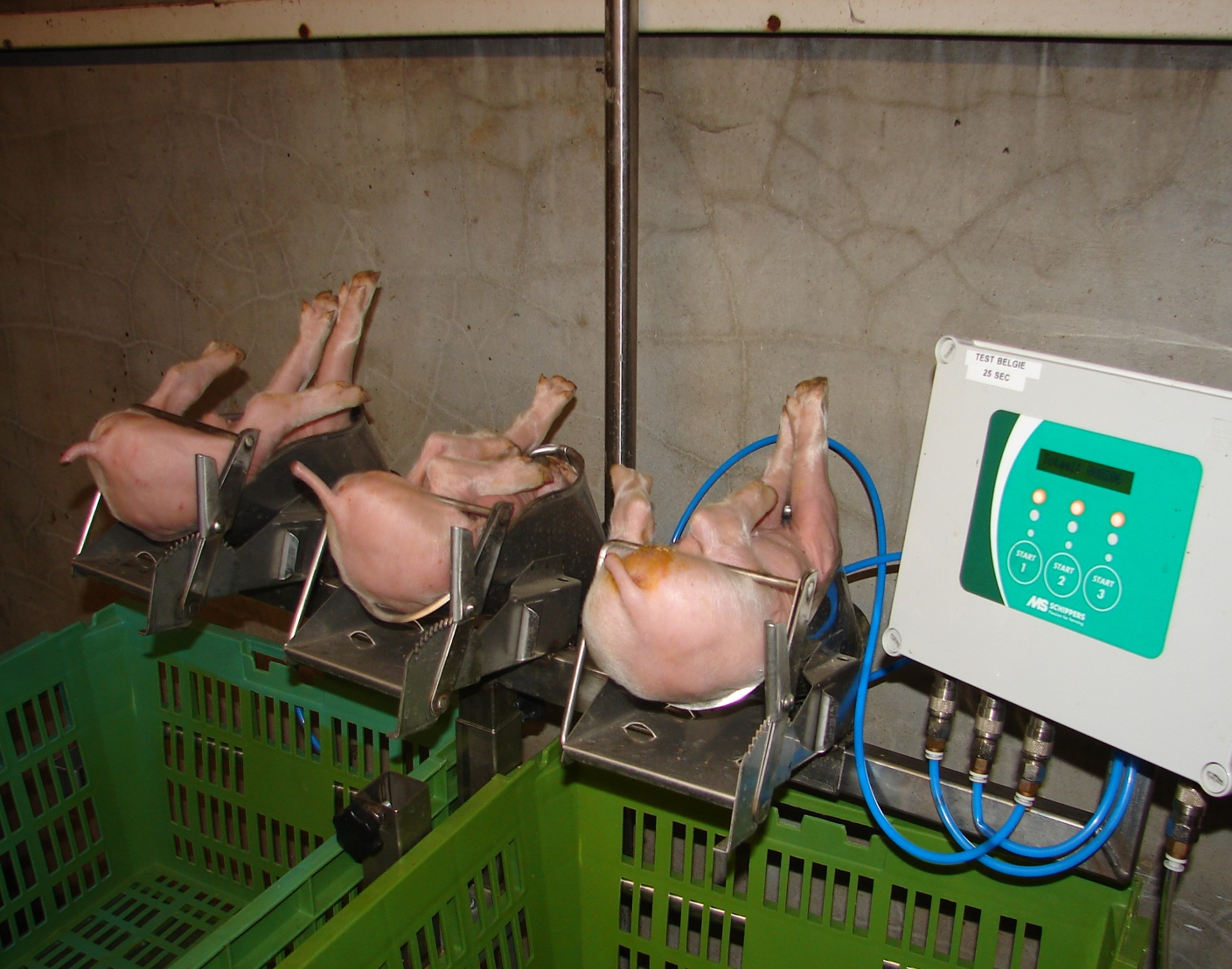
Aim
Surgical castration without anaesthesia (CONT)
Surgical castration with general anaesthesia (CO₂)
Surgical castration with analgesia (MET)
Vaccination against boar taint (VACC)
Entire male pigs (EM)
AIM
Evaluate reliability, feasibility & quality
ANIMAL
Performance
Health
Welfare
FARMER
Attitude
Experience
QUALITY
Boar taint
Meat quality
Carcass quality
All treatments are performed on 20 farms, with 120 male piglets per treatment.
Different sexes are always reared separately

Slide 3
Carcass quality
Farmer
 | BA | VACC vs BA | EM vs BA
Cold carcass weight (kg) | 90.9 | +0.8 | -0.5
Lean meat percentage (%) | 60.8 | +0.5 | +2.0
Meat thickness (mm) | 66.8 | -0.1 | -2.0
Fat thickness (mm) | 14.8 | -0.8 | -2.7
(Cold) Dressing (%) | 81.6 | -1.3 | -1.2

Slide 4
Carcass quality
Farmer
30 out of 120 VACC
identified as EM

Slide 5
Farmer
Carcass quality
ILVO | CONT | CO₂ | MET | VACC | EM | p-waarde
n | 16 | 17 | 18 | 17 | 17
Slaughter weight(kg) | 89.0 | 90.6 | 90.0 | 87.7 | 85.2 | 0.279
Meat percentage(%) | 59.5ª | 59.4ª | 59.7^{ab} | 60.4^{ab} | 62.6^{b} | 0.021
Dressing | 78.9^{c} | 78.6^{bc} | 79.0^{c} | 77.2ª | 77.9^{ab} | <0.001
Stomach-intestines (kg) | 7.7ª | 8.3^{ab} | 7.8ª | 8.9^{b} | 7.6ª | 0.001
Fat (+ testes) (g) | 320 | ? | 400 | 815 | 968

Slide 6
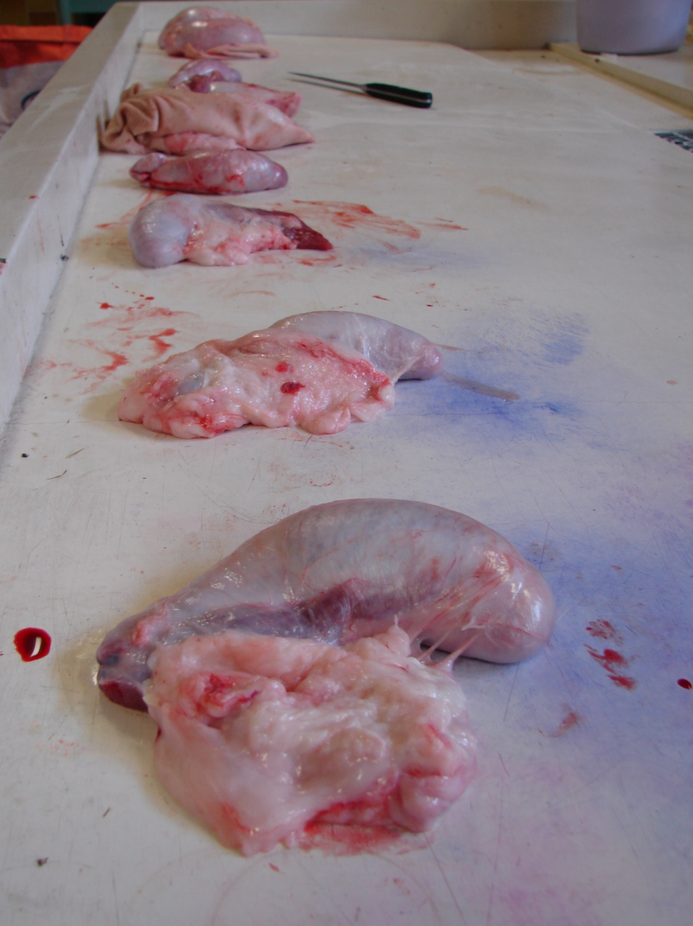
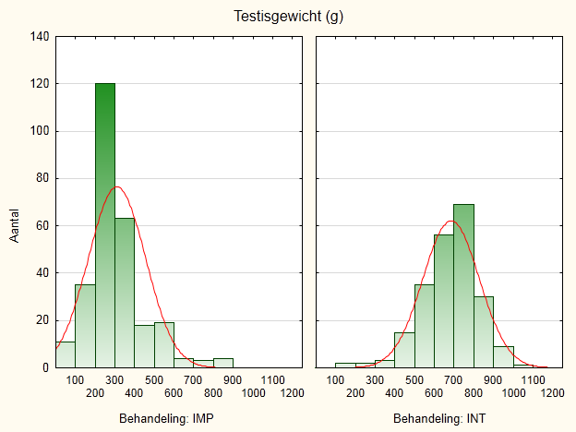
Farmer
Testes weight
Testes weight (g)
96%
17%
Number
VACC
EM

Slide 7
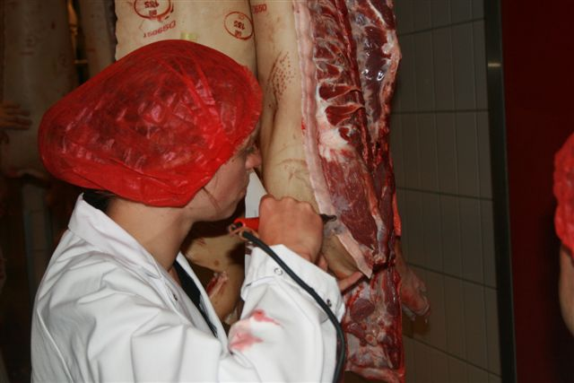
Boar taint
Consumer

Slide 8
Boar taint
Consumer
Farm number | Light boar taint (%) | Strong boar taint (%)
8 | 1 | 0
4 | 3 | 0
15 | 4 | 0
6 | 5 | 0
1 | 6 | 0
19 | 5 | 1
20 | 5 | 1
18 | 14 | 1
13 | 4 | 1
16 | 7 | 2
2 | 8 | 2
3 | 37 | 2
11 | 14 | 2
17 | 10 | 2
9 | 12 | 2
10 | 21 | 3
5 | 10 | 5
7 | 30 | 10
12 | 22 | 10
14 | 26 | 14
Average | 13 | 3
Notes:
Farmsnummers kloppen niet

Slide 9
Slaughter results
  Average results in line with literature
    Lean meat
      VACC +0.5 %
      EM+2.0%
  Farm variation -> management (feed, timing 2th vacc)
  Dressing %
Boar taint
  Average prevalence: 3%
  Farm variation:
    Low and high prevalence boar taint farms
Institute for Agricultural and Fisheries Research
Contact: marijke.aluwe@ilvo.vlaanderen.be
Notes:
voorblad

Slide 10

Aim
Is boar taint the only issue ?

Slide 11
Aim
Extensive evaluation of
Carcass quality
Boar taint
Meat quality measurements
Eating quality
of
Barrows
Vaccinated against GnRH
Entire male pigs

Slide 12
Animals and management
M&M
Animals (Hybrid sow x Pietrain boar)
108 barrows (BA)
  Castrated at 4 days of age
  Standard diet, ad lib
105 vaccinated against GnRH (VACC)
  Improvac ®, 2 ml, subcutaneous
  1st vaccination: 19 weeks
  2nd vaccination: 4 weeks before slaughter
  Standard diet, ad lib
105 entire male pigs (EM)
  Control (n=53): Standard diet, ad lib
  Test (n=47): + 5% chicory pulp + 5% dried chicory roots
Slaughter
All slaughtered at the same day

Slide 13
Carcass quality
Results
Measured at the slaughterline PG200
 | BA | VACC | EM | s.e. | P-value
n | 90 | 98 | 52
Carcass weight (kg) | 93.6 | 92.9 | 90.1 | 0.59 | 0.074
Lean meat (%) | 57.7^{x} | 60.6^{y} | 60.3^{y} | 0.19 | <0.001
Muscle thickness (mm) | 62.4^{y} | 62.5^{y} | 60.4^{x} | 0.31 | 0.021
Fat thickness (mm) | 17.7^{y} | 14.2^{x} | 13.6^{x} | 0.21 | <0.001
VACC better meat thickness compared to EM,
while meat% =

Slide 14
Meat quality
M&M
Boar taint
  Hot iron method (scale 0=neutral to 4=strong)
  Analysis of indole, skatole and androstenone
Ultimate pH
Colour determinants L*,a*,b* -> Hunterlab miniscan
Drip loss (24h)
Shear force
Cooking loss

Slide 15
Boar taint
Results
 | BA | VACC | EM | s.e. | P-value
n | 25 | 46 | 53
Hot iron score | 0.2^{x} | 0.5^{x} | 1.2^{y} | 0.07 | <0.001
0: good
1: very light
2: light
3: strong
4: very strong
14% strong boar taint
26 % light boar taint
Correlation
IND: 0.50
SKA: 0.15
AND: 0.57
Indole: 8%>100 ppb
Skatole:1%>250 ppb
Androstenone: 26%>1000 ppb
More boar taint in EM compared to VACC and BA

Slide 16
Meat quality: pH & colour
Results
 | BA | VACC | EM | s.e. | P-value
 | 97 | 100 | 54
pH_{ultimate} | 5.6^{y} | 5.6^{y} | 5.4^{x} | 0.01 | <0.001
L* (0=black, 100=white) | 57.3 | 56.3 | 57.2 | 0.21 | 0.066
a* (-100=green, +100=red) | 8.5^{x} | 8.9^{y} | 8.8^{xy} | 0.07 | 0.020
b* ( -100=blue, +100=yellow) | 16.4^{xy} | 16.4^{x} | 16.8^{y} | 0.05 | 0.020
Significant effects, but differences are small
Conflicting results in literature

Slide 17
Meat quality: WHC and tenderness
Results
 | BA | VACC | EM | s.e. | P-value
n | 97 | 100 | 54
Drip loss (%) | 2.9^{x} | 3.8^{y} | 3.8^{y} | 0.10 | <0.001
Cooking loss (%) | 28.3^{x} | 30.8^{z} | 29.8^{y} | 0.15 | <0.001
Shear force (N) | 28.0 | 28.4 | 28.1 | 0.30 | 0.778
Water holding capacity is lower for EM and VACC compared to BA
Highest cooking loss for VACC
No effect on shear force / tenderness

Slide 18
Meat quality
Conclusion
 | General | BA | VACC | EM
Carcass quality |  |  | Lean Meat thickness↑ | Lean
Meat quality | Small differences
Boar taint |  |  |  | Present!
Colour |  |  | Red ↑ | Yellow ↑
pH_{ultimate} |  |  |  | Lowest
Drip loss |  |  | Highest | Highest
Cooking loss |  | Lowest | Highest | Intermediate
Shear force | No effect
? Eating quality ?

Slide 19
Eating quality
M&M
  Home consumer panel (n=400)
  Cook + taster
  Evaluation of
    Colour, odour, flavour, juiciness, tenderness, general
    Colour uncooked, cooking odour (cook)
  1 meat package/week with 4 cuts/animal
    On three consecutive weeks
    Balanced design

Slide 20
Eating quality
M&M
Good
VACC
EMP
P=0.044
y xy x
Bad
Boar taint? Tenderness!

Slide 21
Eating quality
M&M
Good
VACC
EMP
P=0.049
P=0.087
Bad
Boar taint? Juiciness!

Slide 22
Is boar taint the only issue ?
Boar taint
Drip & cooking loss
Meat quality measurements
↕
Eating quality
Tenderness
Juiciness
Institute for Agricultural and Fisheries Research
Contact: marijke.aluwe@ilvo.vlaanderen.be
Notes:
voorblad

Slide 23
Thank you for your attention !
Conclusions
Lean meat: VACC +0.5 %; EM+2.0%
    Farm variation -> management
Boar taint prevalence: 3%
  Low and high prevalence boar taint
Meat quality measurements <-> Eating quality
  Boar taint & tenderness
Part 1
Part 2
Institute for Agricultural and Fisheries Research
Contact: marijke.aluwe@ilvo.vlaanderen.be
Notes:
voorblad

