Slide 1






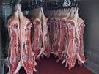
SIDA-HS-SPME-GC/MS- a candidate reference method for the simultaneous quantitation of boar taint compounds in back fat

Slide 2
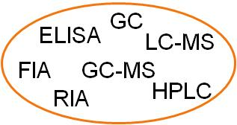
Status Quo
there are several analytical procedures on the market
to quantify boar taint compounds in back fat samples
there is still no official reference method for the detection of skatole and androstenone within the EU
different researchers use different methods→ bad for the comparability of the result
a harmonized reference method will be essential for different reasons:
  to determine odor thresholds
  to set consumer acceptance limits
  to verify of rapid methods
  to evaluate breeding and feeding experiments

Slide 3
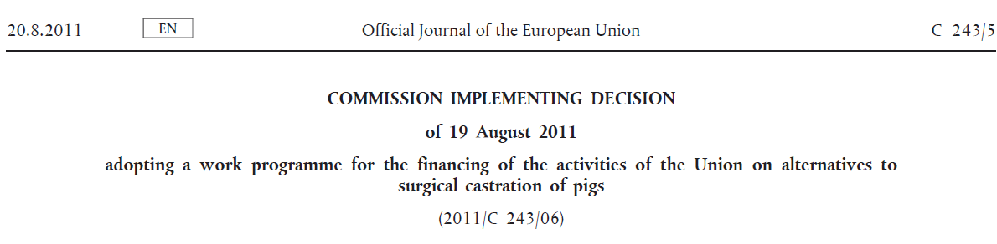
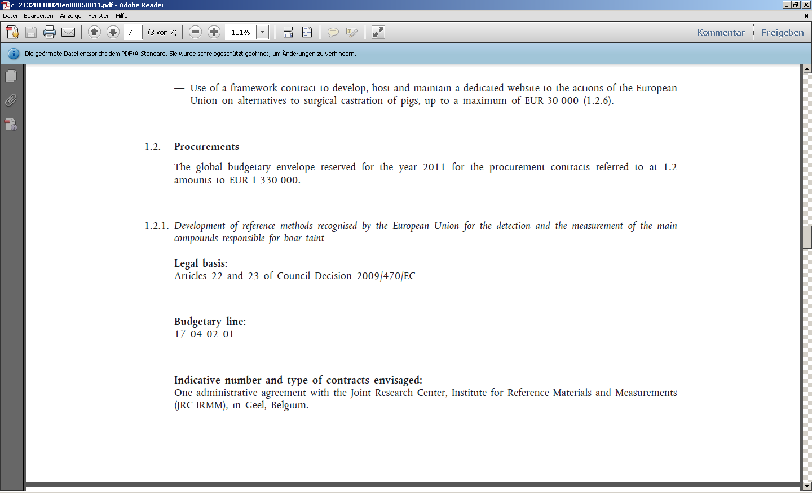
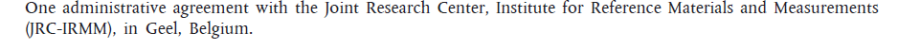
Latest development: EU‘s implementing decision
“Boars heading for 2018“ - Scientific Satellite Program Amsterdam 02.12. 2011

Slide 4
The novel
SIDA-HS-SPME-GC/MS method
“Boars heading for 2018“ - Scientific Satellite Program Amsterdam 02.12. 2011

Slide 5
Method details - SIDA (stable isotope dilution analysis)
Isotopic standard (d₃-Androstenone) and the corresponding target analyte (Androstenone) have nearly identical properties
(structure, boiling point, solubility)
SIDA describes the use of isotopic labeled internal standards
d₃-Skatole
Androstanone
(commonly used)
Androstenone
(target compound)
d₃-Androstenone
(isotopic standard)
d₆-Indole
d₃-Androstenone
Target analyte and isotopic standard behave similar during
sample preparation and chromatography
SIDA achieves high accuracy and precision and
thereby delivers reliable results
d₃ -β- Androstenol
J. Fischer, P. W. Elsinghorst, M. Wüst,
J. Label Compd. Radiopharm 2011, 54, 591-596.

Slide 6
Method details - Sample preparation
separate connective tissue
spike standard
melt fat
spike standard
mix thoroughly
until equillibration!
500mg fat
MS-detection
add 1mL MeOH,
mix again thoroughly
for analyte extraction
headspace
solid phase microextraction
HS-SPME
evaporate to dryness
separation by freezing at -10°C
fat-solvent
mixture
methanolic
supernatant
Notes:
Now let’s have a look at the sample preparation. For sample preparation we melt the diced back fat samples in a microwave and after melting we separate the connective tissue from the liquid fat. Then we weigh in 500mg liquid fat and add the isotopic internal standards. After spiking it is important to mix thoroughly in order to dispense the isotopic standard equally within the fatty matrix. After reaching equilibration, the liquid fat is mixed thoroughly with methanol to achieve analyte-extraction. Subsequently, the fat-solvent mixture is again separated by a combined freezing and centrifugation step. The obtained methanolic supernatant is decanted into a headspace vial, evaporated to dryness in a stream of compressed air and finally passed to the fully automated HS-SPME-GC/MS procedure.

Slide 7
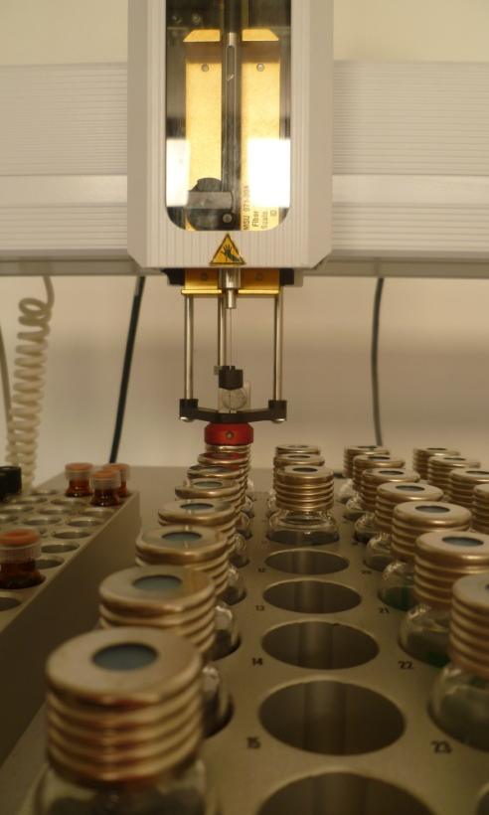
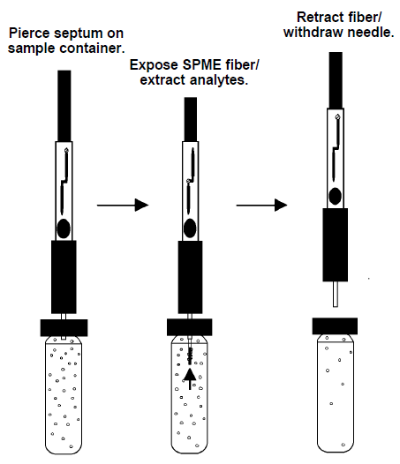
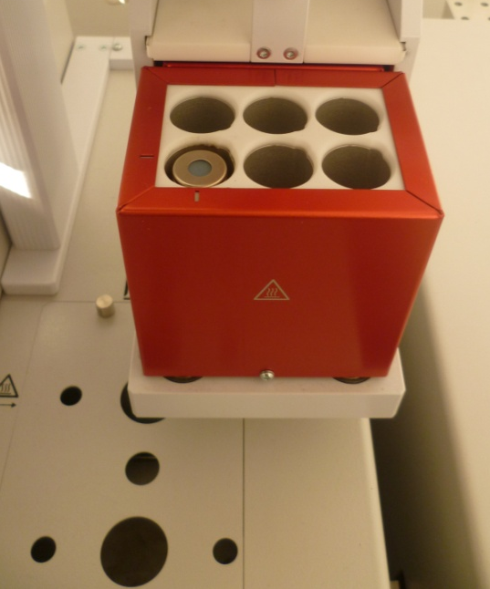
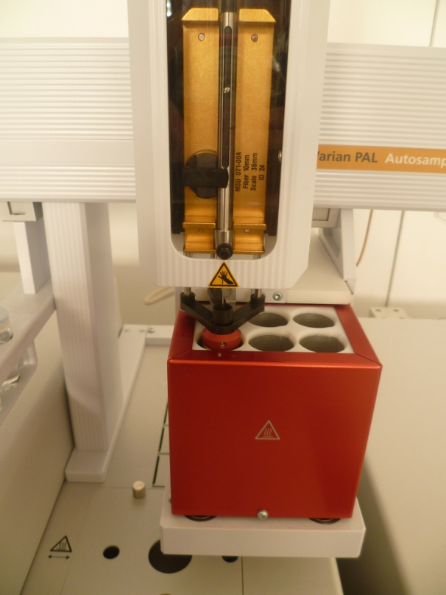
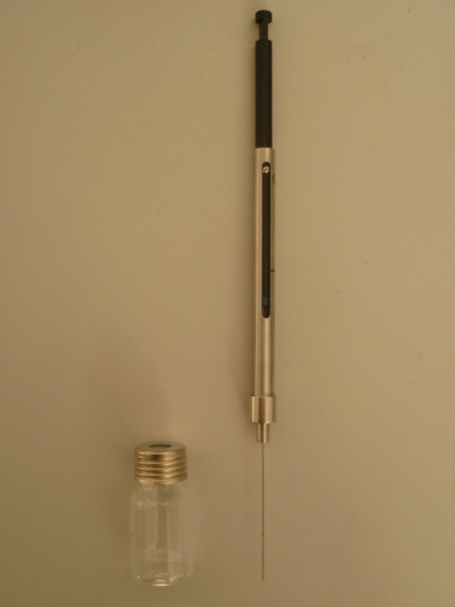
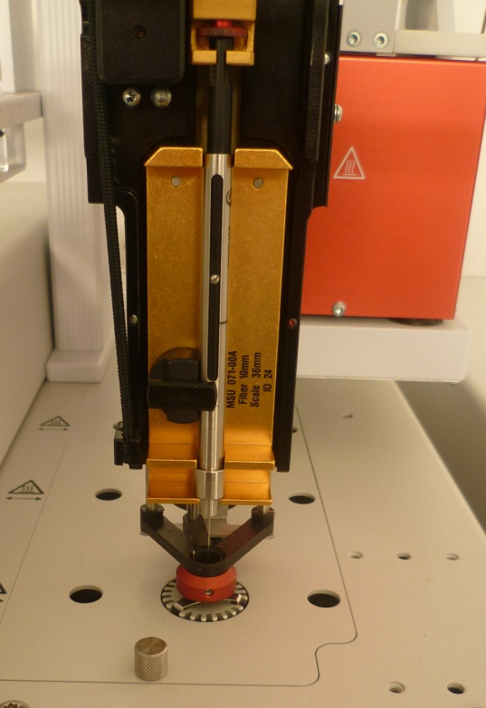
Method details – HS-SPME sampling
Equillibration:
5min at 100°C
Extraction:
30min at 100°C
Desorption:
20min at 270°C

Slide 8
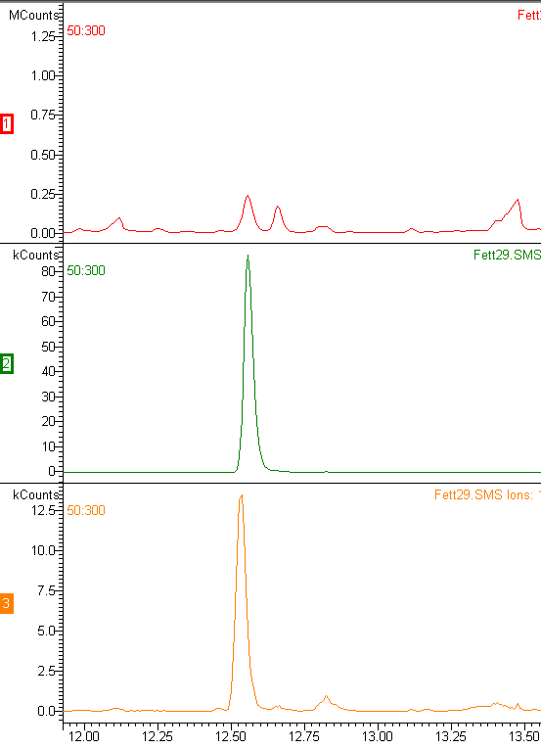
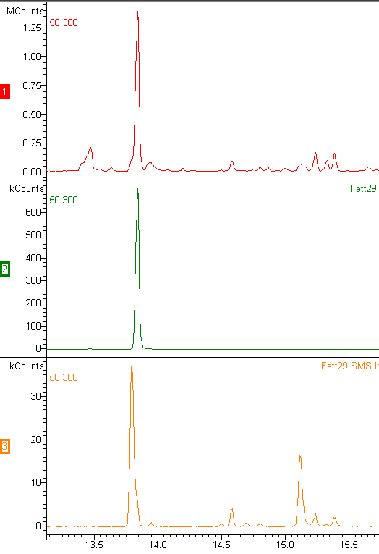
Method details – GC/MS detection (indolic compounds)
Chromatograms were obtained from a conventionally fattened intact boar!
Indole
Skatole
Full Scan
Chromatogram recorded
by scanning from
(m/z)50 to (m/z)300
SIM
430 ng/g
925 ng/g
(m/z) 117
(m/z) 130
Chromatogram analyzed
by displaying the
specific mass lanes of
analyte and isotopic standard
SIM
(m/z) 122+123
(m/z) 133+134
“Boars heading for 2018“ - Scientific Satellite Program Amsterdam 02.12. 2011

Slide 9
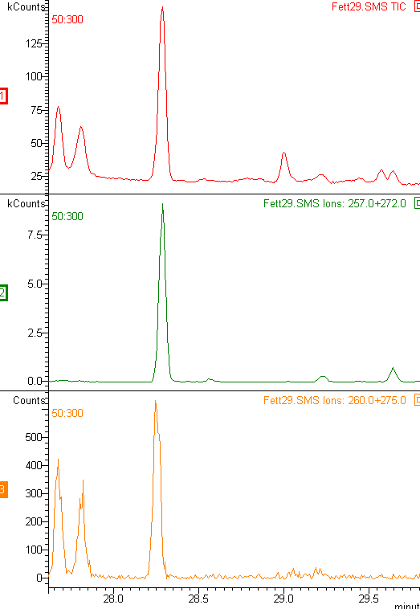
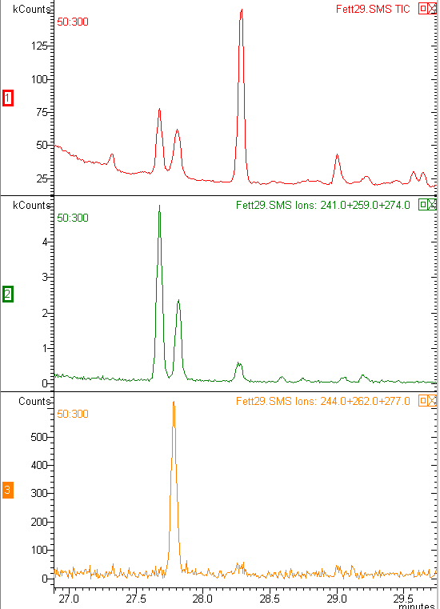
Method details – GC/MS-detection (pheromones)
Androstenone
Androstenols
Full Scan
SIM
3α-Androstenol, 1199 ng/g
3797 ng/g
(m/z) 241+259+274
(m/z) 257+272
3β-Androstenol, 704 ng/g
SIM
…contribution of
the androstenols
to boar taint?
(m/z) 260+275
(m/z) 244+262+277
“Boars heading for 2018“ - Scientific Satellite Program Amsterdam 02.12. 2011

Slide 10
Method details - Validation
 | Working range (ng/g) | Limit of detection (ng/g) | Limit of quantitation (ng/g)
Skatole | 0.5 - 1000 | 0.1 | 0.5
Indole | 1 - 1000 | 0.5 | 1
Androstenone | 60 – 5000 | 35 | 60
3α-Androstenol | 70-5000 | 50 | 70
3β-Androstenol | 65-5000 | 45 | 65
Intra-day (n = 4) | Accuracy (R.E.) |  | Precision (R.S.D.)
 | low (ng/g) | high (ng/g) | low (ng/g) | high (ng/g)
Androstenone | 2,5% (500) | -1,7% (2500) | 4,0% (500) | 5,5% (2500)
Skatole | -8,1% (50) | 1,8% (500) | 3,0% (50) | 5,0% (500)
Inter-day (n = 4) | Accuracy (R.E.) |  | Precision (R.S.D.)
 | low (ng/g) | high (ng/g) | low (ng/g) | high (ng/g)
Androstenone | -1,1% (500) | 1,3% (2500) | 4,1% (500) | 4,0% (2500)
Skatole | -8,0% (50) | 5,4% (500) | 1,3% (50) | 2,1% (500)
Fischer et al,
Anal. Chem. 2011,
83, 6785-6791.

Slide 11
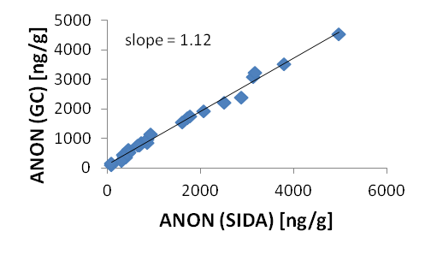
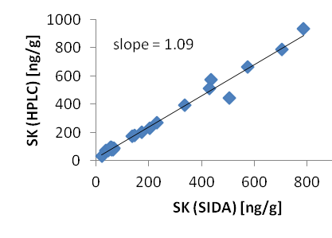
Method details - Validation
Cross-Validation
Comparison of the results of 25 back fat samples obtained by SIDA-GC/MS,
with the results obtained by GC-MS (Androstenone) and RP-HPLC-FD (Skatole)
Similar results with different methods as indicated by a slope close to 1!
Cross-Validation again confirms that SIDA-GC/MS delivers reliable results
“Boars heading for 2018“ - Scientific Satellite Program Amsterdam 02.12. 2011

Slide 12
Summary- SIDA-HS-SPME-GC/MS
Pros
Cons
Fast and simple sample preparation with low solvent use (1mL)
The application of SIDA eliminates matrix effects and thereby delivers reliable results
SPME avoids fat associated column contamination
Simultaneous quantitation of indole, skatole, androstenone, α- and β-androstenol
Reliability confirmed by validation
Lack of commercially available labeled standards
organic synthesis necessary

Slide 13




Thank you for your attention!!!
This project was
financed by:
contact : Jochen Fischer
Rheinische Friedrich-Wilhelms-Universität Bonn
Institut für Ernährungs- und Lebensmittelwissenschaften/Abteilung Bioanalytik
Endenicher Allee 11-13, D-53115 Bonn
email: jochen.fischer@uni-bonn.de

