Slide 1

Boars in the European Union
History, state of affairs and challenges for the years to come
Gé Backus
Amsterdam, November 30, 2011

Slide 2
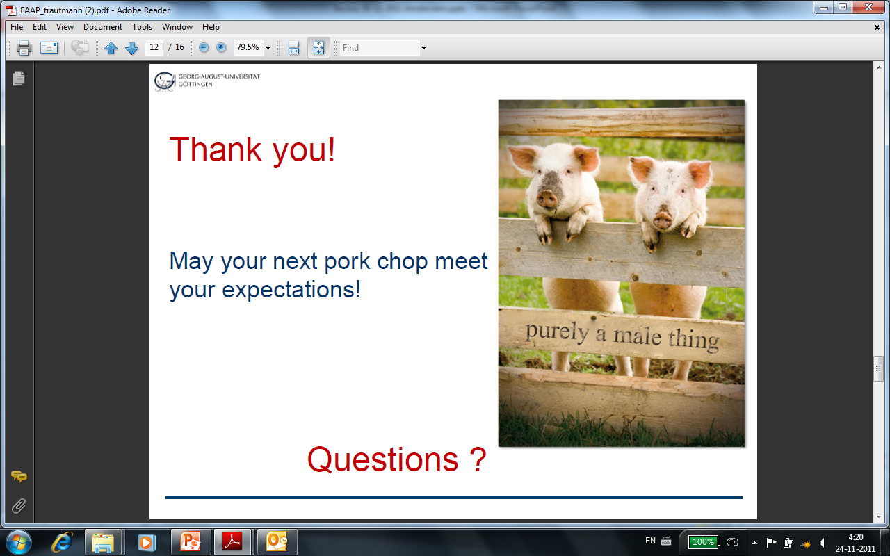
Contents presentation
Castration
Setting the stage
Castration practices in the EU
Societal concerns: issues life cycle
Media attention for castration
Developments in the Netherlands
Observations
Myths and sagas
Challenges
Conclusions

Slide 3
Castration
Boar taint: penetrating unpleasant odour in pork
Animal welfare (100 million castrated piglets per year in EU)
Less feed efficiency (700.000 ha more land needed)
Removing taint condition for market acceptance

Slide 4
Setting the stage
Sense of urgency increases in several countries
  media coverage, societal concerns
  countries in different stages of issues life cycle
International dimension
  Declaration of Brussels unites parties in their ambition
Uneven distribution benefits and costs
Lack of information induces risks

Slide 5
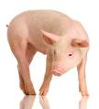
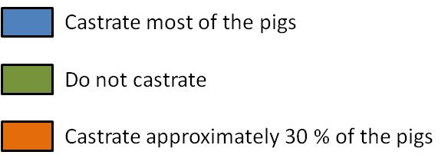
Practice on castration of piglets (2008)
Castrate most pigs
Do not castrate
Castrate + 30%

Slide 6
Societal concerns: castration
Level of public attention
Legislation or self-regulation
Regulation /
Certification
Public action and pressure
Public indignation
and mobilisation
Issue fatigue
Societal concerns
Media attention
Uneasiness with opinion leaders
Calm environment
Initiation
Growth
Development
Mature
Post mature

Slide 7
Media attention
‘Castration’ in the national newspapers
% of articles 2002-2011
Source: Lexis Nexis

Slide 8
Recent developments in the Netherlands
Strong sense of urgency since 2006
Media coverage and high citizen awareness on the issue
Proclamation of Noordwijk, November 2007
2010: Strategic situation with high uncertainty level
Situation November 2011
Dutch retail only sells meat from non castrated pigs
40% of Dutch male piglets not castrated anymore
and entire male pigs marketed based on quality assurance protocols
Pork meat consumption same development compared to poultry
Retail and food service satisfied and benefiting from better reputation
Farmers have lower feed cost
More sustainable production (lower carbon food print, less arable land)

Slide 9
Observations
NGO's driving factor
Market initiatives emerge, backed by research
New research projects in many EU countries
Countries differ in perceived sense of urgency
Uneven distribution benefits and risks across chain
Battle between good, better, and best
Lack of information based on ‘sound science’

Slide 10
Myths and sagas about boar taint
More than 20% of boars have boar taint
Gilts and barrows can’t produce boar taint
Skatole is the major boar taint compound
Consumers dislike Androstenone
Boar taint inherits from the boar side

Slide 11
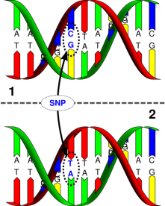
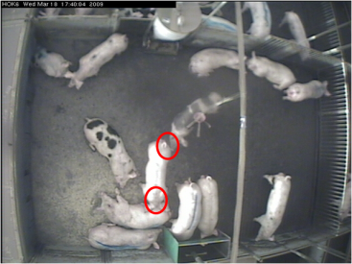
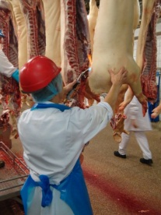
Challenges
Solutions to produce and market entire male pigs
  Preventive measures to reduce boar taint
    Breeding, feeding, farm management
  Safety net by detection at slaughter-line
No shift to another welfare problem
  Preventing aggressive behaviour by housing and feeding

Slide 12
Conclusions
Making progress on an age old issue
Gigantic and successful leap forward in Dutch market
  Each country has it’s own clock speed
Myths and sagas about boar taint gradually unravelled
Learning from each other crucial to success of the Declaration of Brussels

Slide 13
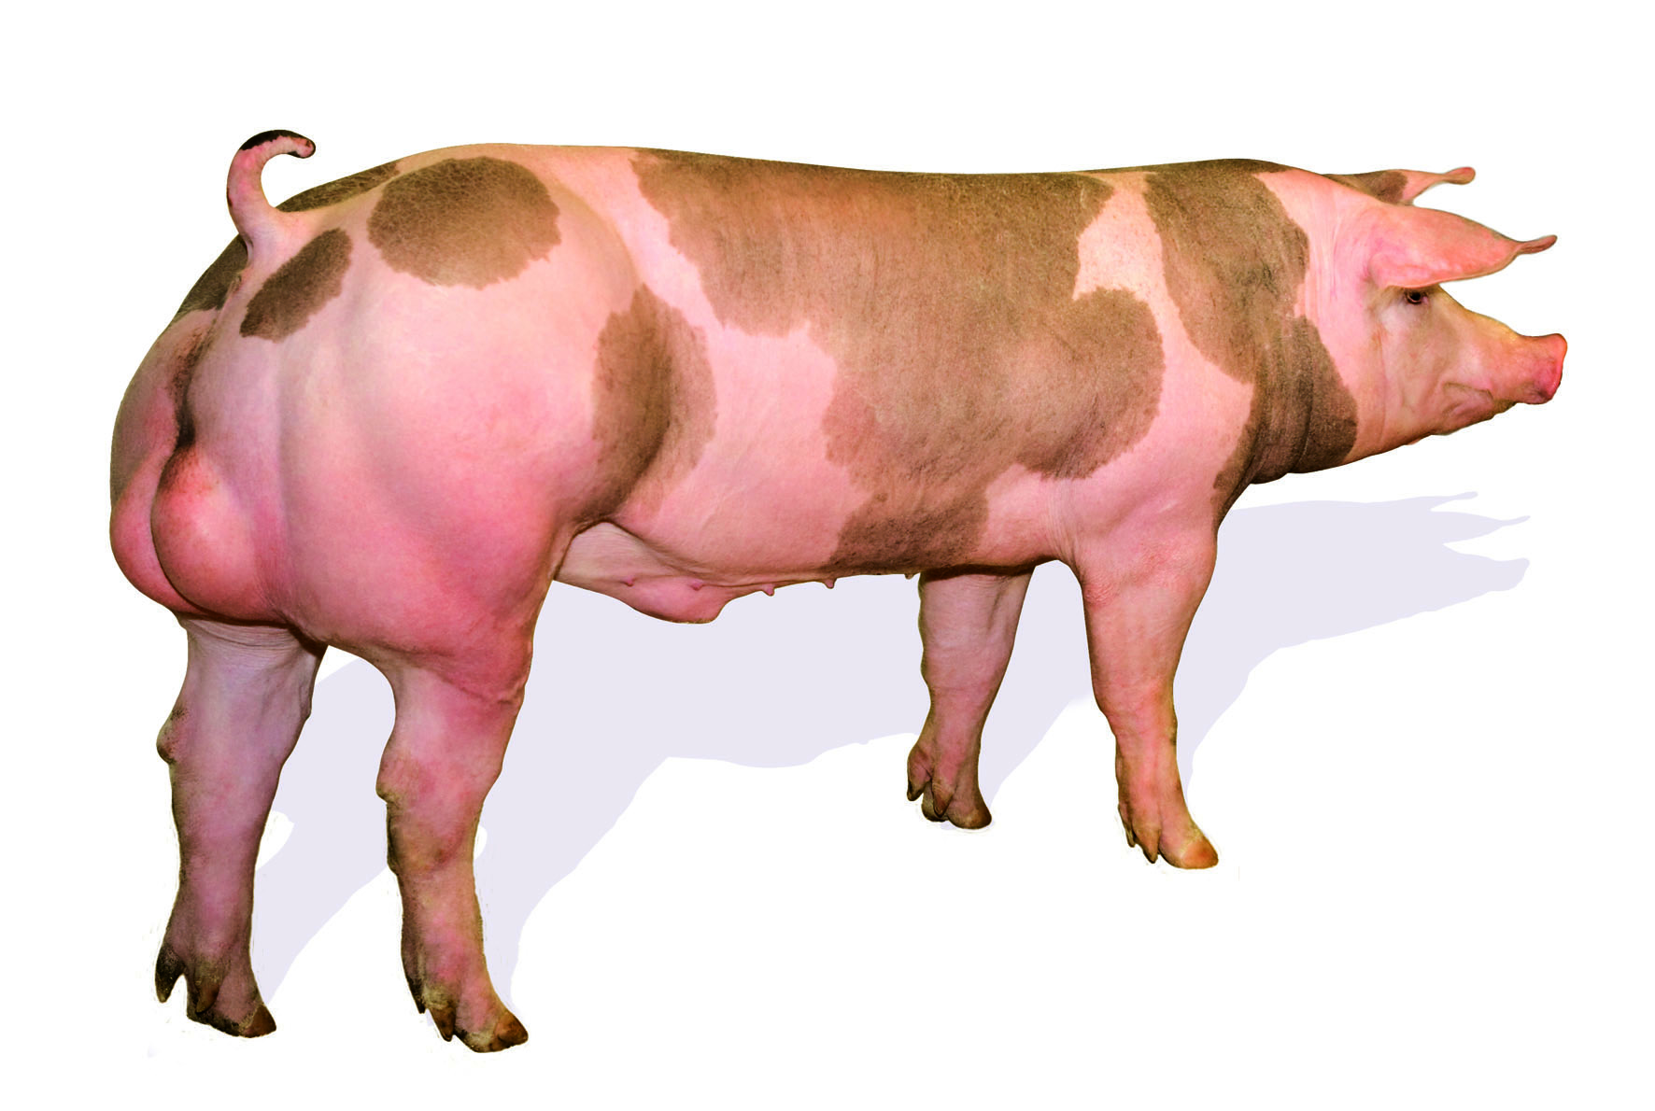

Thank you for your attention!
ge.backus@wur.nl

